Slide 1
Automatización de grandes edificios
Modbus, M-bus, knx, dmx, dali

Slide 2
introduccion
*Con nuestros potentes sistemas DDC (Direct Digital Control System) automatizamos grandes edificios con hasta 200.000 puntos de datos.
*Disponemos de dispositivos basados ​​en Ethernet para controlar la calefacción, el aire acondicionado y la ventilación.
*Nuestros productos controlan todo tipo de luces incluyendo los estándares EIB, DALI o MODBUS.
*Todo el consumo dentro de un edificio puede ser capturado por nuestra línea de productos MBUS, para realizar por ejemplo, un procedimiento de facturación de energía.
En general, podemos mostrar todas las informaciones del edificio centralizadas y distribuidas a través de centros de control y pantallas. El utilizar interfaces estándar como MODBUS, OPC o RS232 nos permite conectar con nuestro centro de control de seguridad.

Slide 3
PRODUCTOS CON INTERFACE SERIE (RS232/RS485)
Smart Meter
  Mbus to Modbus
Light
  DALI to Modbus
  DMX to Modbus
  LED a Modbus
  4LED a Modbus
  KNX Gateway
  KNX a Modbus
  2RTD a Modbus

Slide 4
A. Smart Meter:
Mbus to Modbus; Serial converter from RS232/RS485 to MBUS for max. 48 meters and max. 600 variables.
Consisting of a serial MeterBus Converter, connection to host via RS232 or RS485 with up to 48 meter (=unit loads) and 600 variables, MBUS communication speed from 300bps to 38400 bps, Modbus connection with RS232 (9600 bps to 57600 bps), Mbus and Modbus are galvanically isolated, configuration via PC software, mountable on 35mm EN50022 DIN rail, weight 60g, dimensions (LxWxH) 17.5x90x58mm, power supply 24 VDC, power consumption <2.5W, Free software download

Slide 5
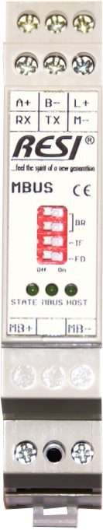
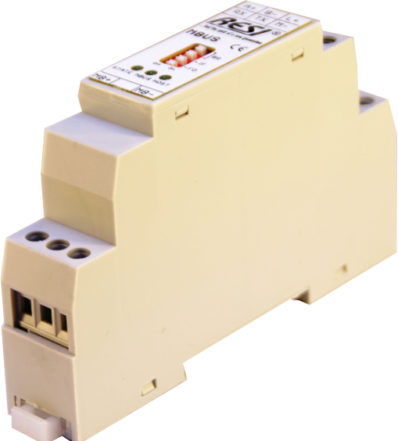
Mbus to Modbus

Slide 6
B. Light (Luz):
DALI to Modbus; Serial converter from RS232/RS485 to DALI master for max. 64 DALI lamps.
Connects a host with MODBUS/RTU master interface to DALI bus, host communication: via RS232 or RS485 with MODBUS/RTU slave protocol, host baud rates: 9600, 19200, 38400 or 57600Bd, no parity, 8 data bits, 1 stop bit, All 64 DALI slave addresses, 16 DALI groups and 16 DALI scenes are supported, DALI and MODBUS interface are galvanically isolated, configuration of DALI lamps with free PC software MODBUS configurator, weight: 55g, dimension (LxWxH): 17,5x90x58mm, power supply: 24V=, power consumption: <0.5W, mountable onto a EN50022 DIN rail.

Slide 7
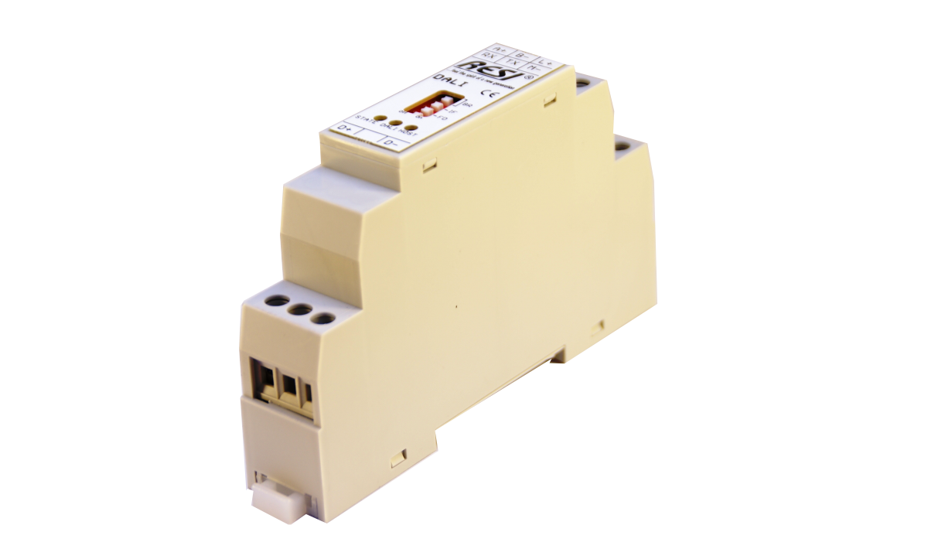
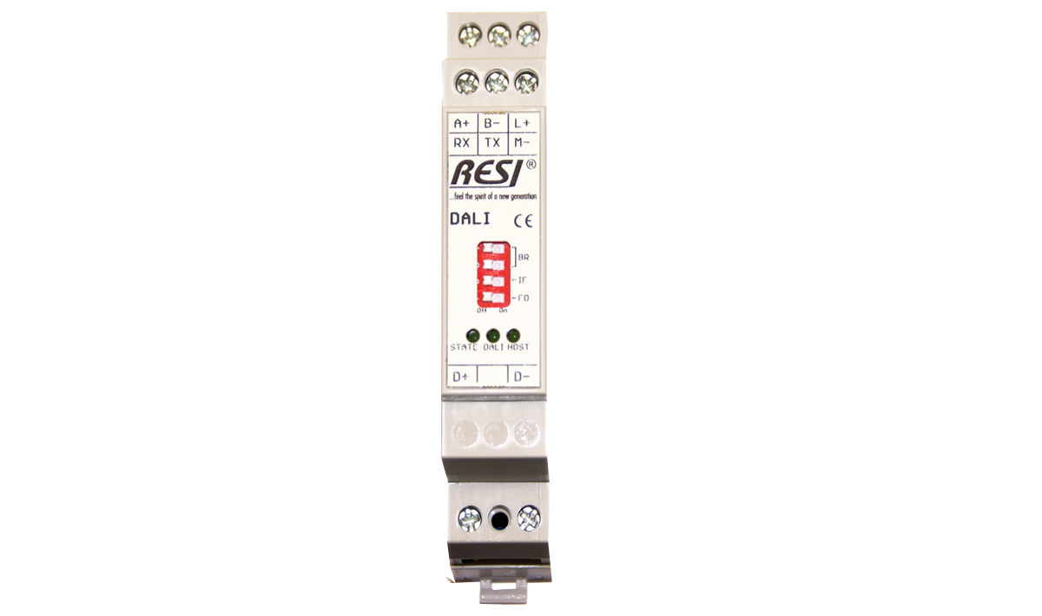
DALI TO MODBUS

Slide 8
B. Light (Luz):
DMX to Modbus; Serial converter from RS232/RS485 to a DMX light system for max. 512 DMX registers.
Connects a host with MODBUS/RTU master interface to a DMX light system, Host communication: via RS232 or RS485 with MODBUS/RTU slave protocol, Host baud rates: 9600, 19200, 38400 or 57600Bd, no or even parity, 8 data bits, 1 stop bit, The complete DMX universe with 512 DMX registers is supported, DMX and serial RS232/RS485 interface is galvanic isolated, Configuration and testing of DMX lamps with free PC software MODBUS configurator, Weight: 55g, Dimension (LxWxH): 17,5x90x58mm, Power supply: 24V=, Power consumption: <0.5W, Mountable onto a EN50022 DIN rail.

Slide 9
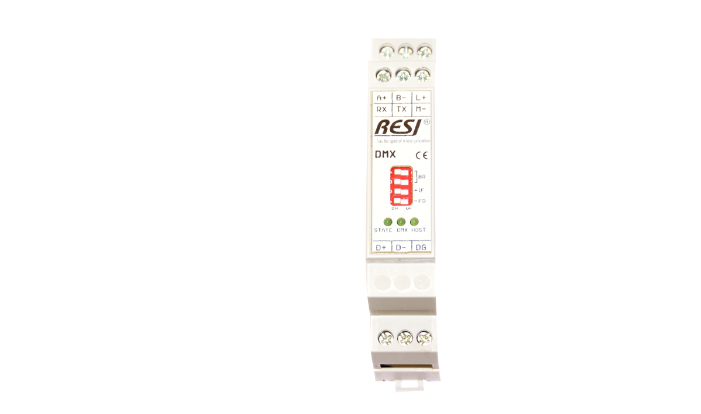
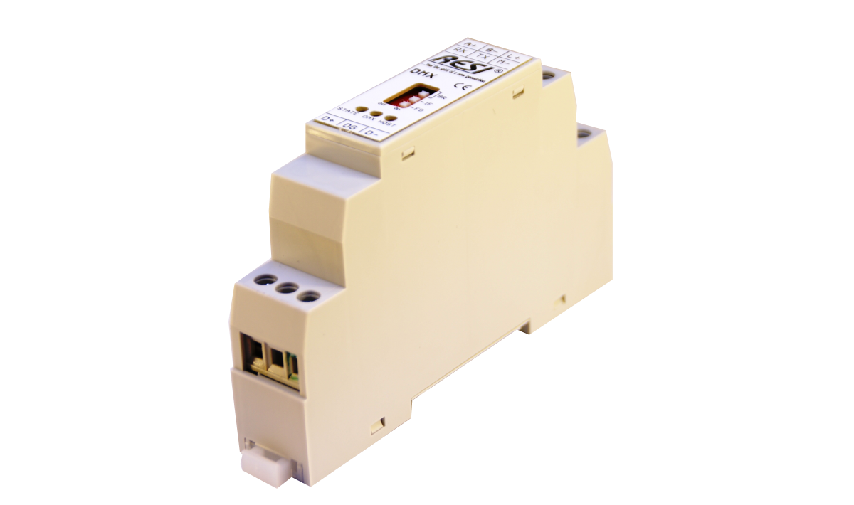
DMX TO MODBUS

Slide 10
B. Light (Luz):
LED a Modbus; Serial interface module from RS232/RS485 with MODBUS/RTU slave protocol to 3 dimmable PWM LED output channels for direct connection of LED stripes (RGB, dual white or monocolour LED stripes)
MODBUS/RTU module to control LED stripes with three individual dimmable channels via serial bus, suitable for RGB, dual white or mono color LED stripes with common anode, separated power supply for LED stripes 0..48Vdc, max. 360W@24Vdc, 180W@12Vdc, 720W@48Vdc, max. 15A input current, max. output current per channel 5A, 3 PowerMOS FET PWM outputs with 400Hz PWM frequency for dimming of the LED stripes, Host communication: via RS232 or RS485 with MODBUS/RTU slave protocol, Host baud rates: 9600, 19200, 38400 or 57600Bd, no, even or odd parity, 8 data bits, 1 stop bit, the three LED outputs are galvanically insulated from the serial interfaces, configuration and testing of module with free PC software MODBUS configurator, Weight: 60g, Dimension (LxWxH): 17,5x90x58mm, Power supply: 12-48V=, Power consumption: <0.6W, Mountable onto a EN50022 DIN rail.

Slide 11
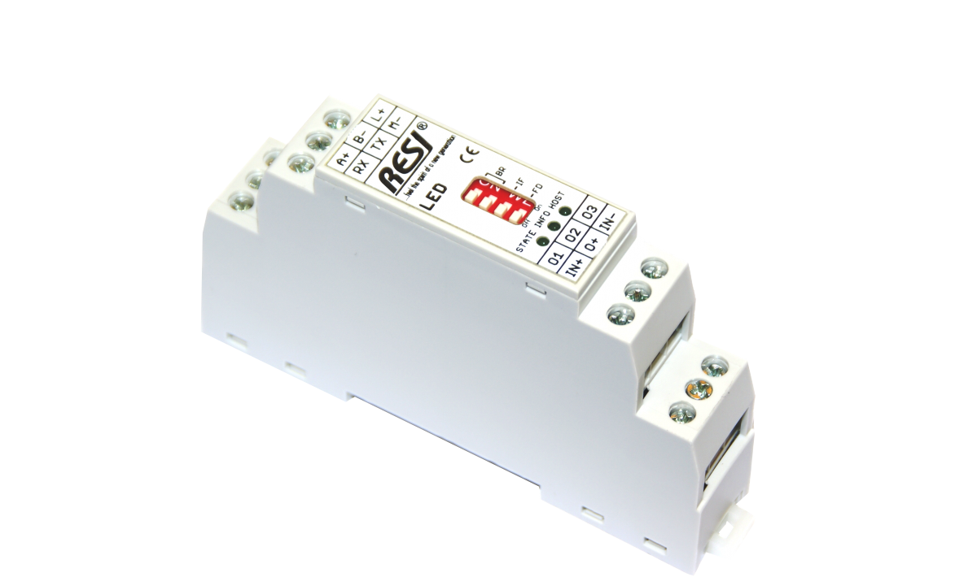
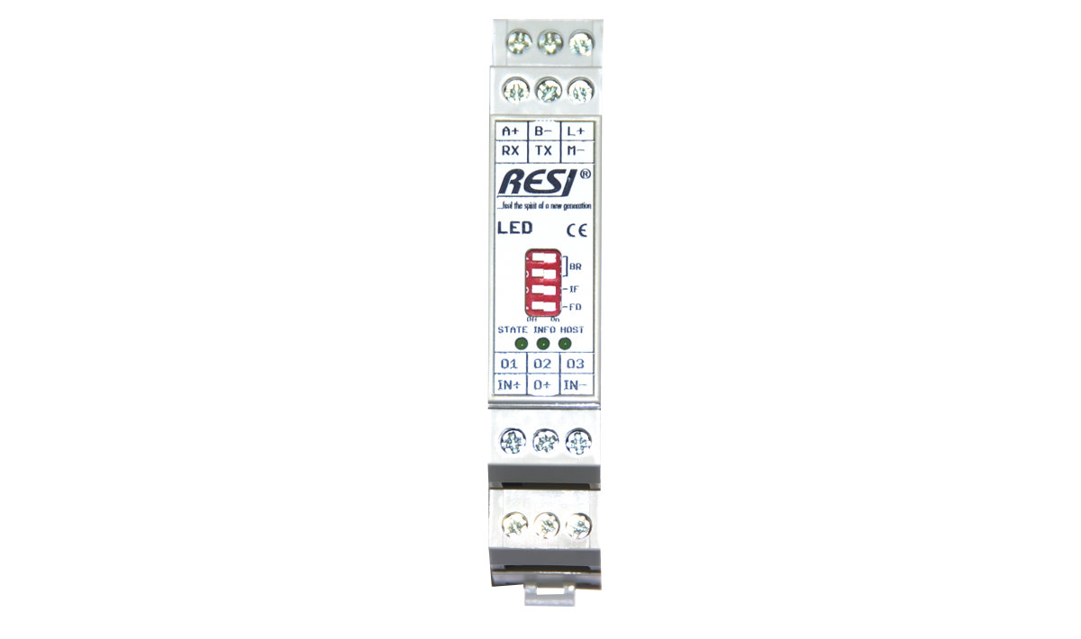
Led to modbus

Slide 12
B. Light (Luz):
4LED a Modbus; Serial interface module from RS485 with MODBUS/RTU slave protocol to 12 dimmable PWM LED output channels for direct connection of LED stripes (RGB, dual white or monocolour LED stripes)
MODBUS/RTU module to control LED stripes with twelve individual dimmable channels, organized in four LED groups with three channels each, via serial bus, suitable for RGB, dual white or mono color LED stripes with common anode, separated power supply for each of the four LED groups 0..48Vdc, max. 360W@24Vdc, 180W@12Vdc, 720W@48Vdc, max. 15A input current per LED group, max. output current per channel 5A, 12 PowerMOS FET PWM outputs with 400Hz PWM frequency for dimming of the LED stripes, Host communication: via RS485 with MODBUS/RTU slave protocol, Host baud rates: 4800, 9600, 19200, 38400, 57600, 115200, 230400 or 256000, no or even parity, 8 data bits, 1 stop bit, the twelve LED outputs are galvanically insulated from the serial interface, configuration and testing of module with free PC software MODBUS configurator, Weight: 260g, Dimension (LxWxH): 143x110x62mm, Power supply: 12-48V=, Power consumption: <0.8W, Mountable onto a EN50022 DIN railor wall mounting

Slide 13
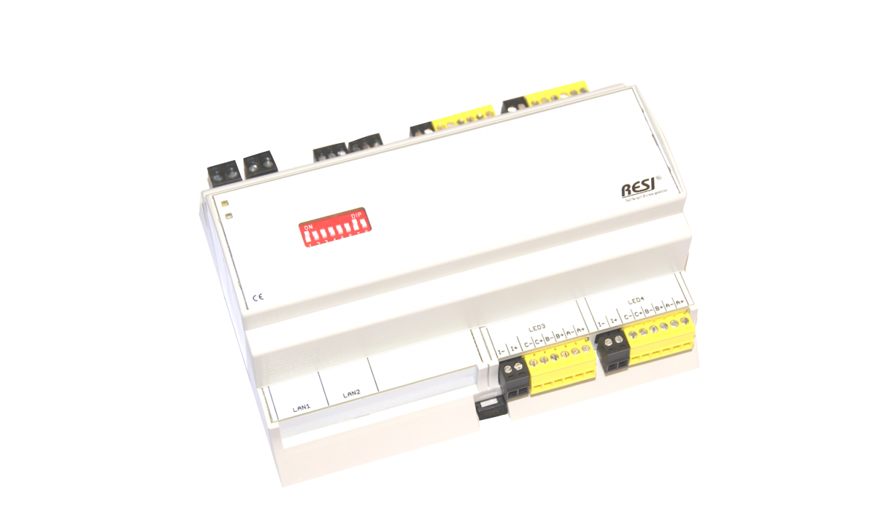
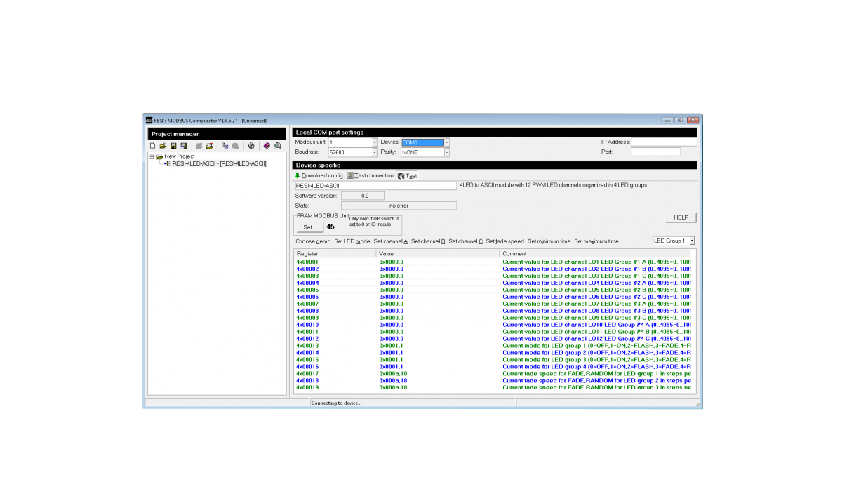
4LED to Modbus

Slide 14
B. Light (Luz):
KNX Gateway; Serial gateway from RS232/RS485 to KNX for max. 32768 KNX group addresses.
Connects a host with ASCII string interface to EIB/KNX bus, Host communication: via RS232 or RS485 with simple ASCII strings, Host baud rates: 9600, 19200, 38400 or 57600Bd, no or even parity, 8 data bits, 1 stop bit, All 32768 EIB/KNX groups are supported, Galvanic insulation between EIB/KNX and serial interface, Configuration of EIB/KNX groups with ASCII strings, Weight: 55g, Dimension (LxWxH): 17,5x90x58mm, Power supply: 24V=, Power consumption: <0.5W, Mountable onto a EN50022 DIN rail.

Slide 15
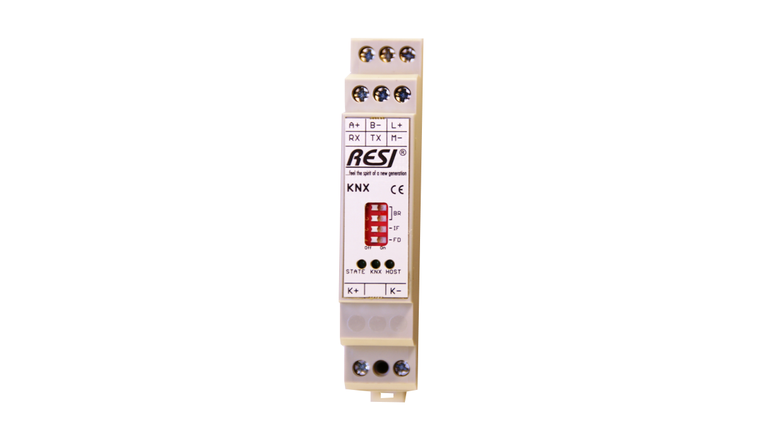
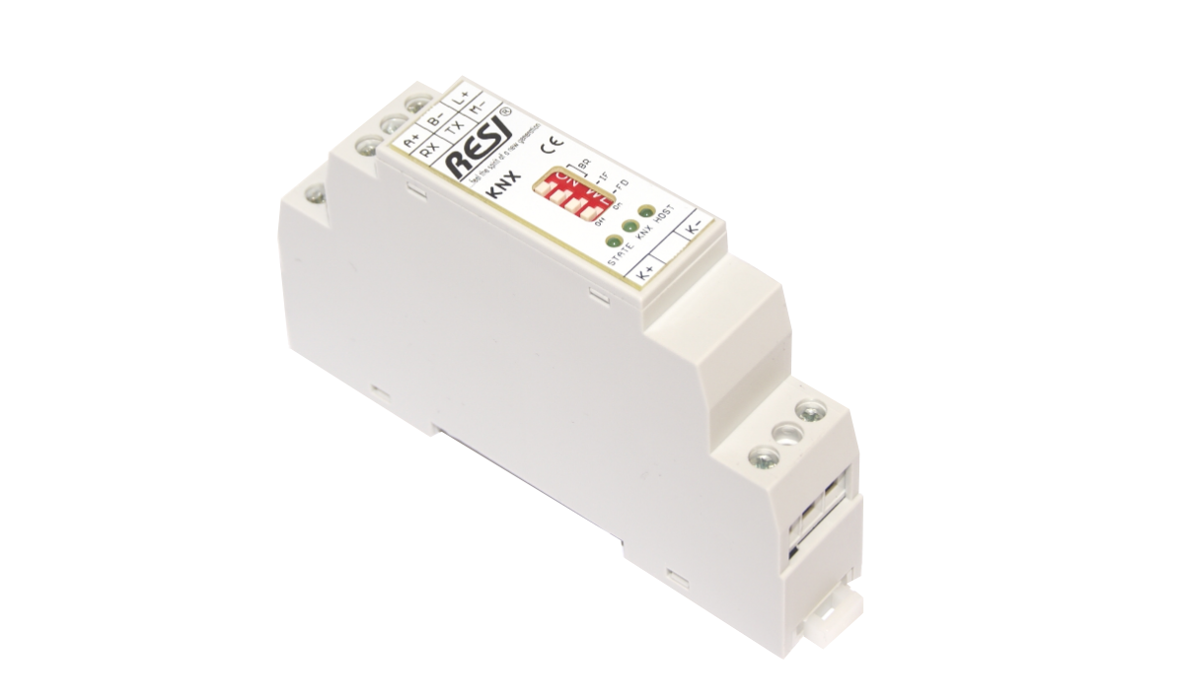
KNX GATEWAY

Slide 16
B. Light (Luz):
KNX a Modbus; Serial gateway from RS232/RS485 with MODBUS/RTU Slave Protocol to KNX for max. 32768 KNX group addresses.
Connects a host with MODBUS/RTU interface to EIB/KNX bus, Host communication: via RS232 or RS485 with MODBUS/RTU protocol, Host baud rates: 9600, 19200, 38400 or 57600Bd, no or even parity, 8 data bits, 1 stop bit, all 32768 EIB/KNX groups are supported, Galvanic insulation between EIB/KNX and serial interface, mapping table size: 300 configuration entries, configuration of EIB/KNX groups, MODBUS holding registers and datatypes with our free PC software MODBUS configurator, Weight: 55g, Dimension (LxWxH): 17,5x90x58mm, Power supply: 24V=, Power consumption: <0.5W, Mountable onto a EN50022 DIN rail.

Slide 17
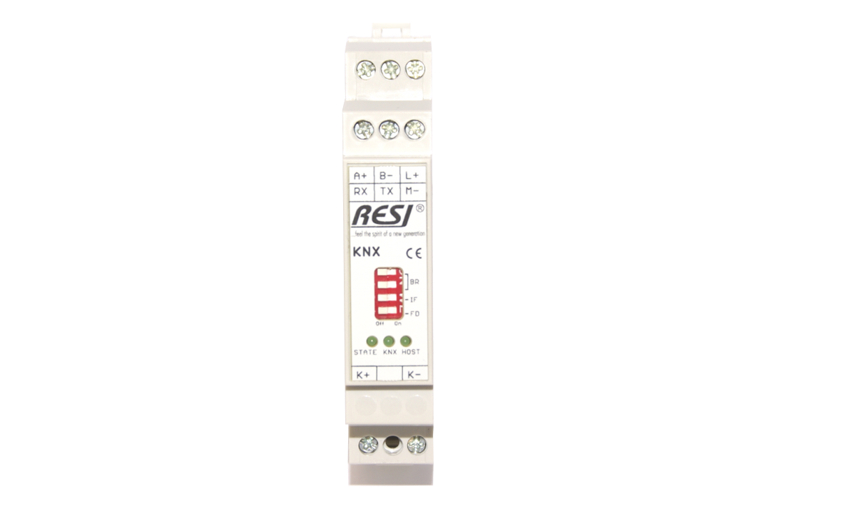
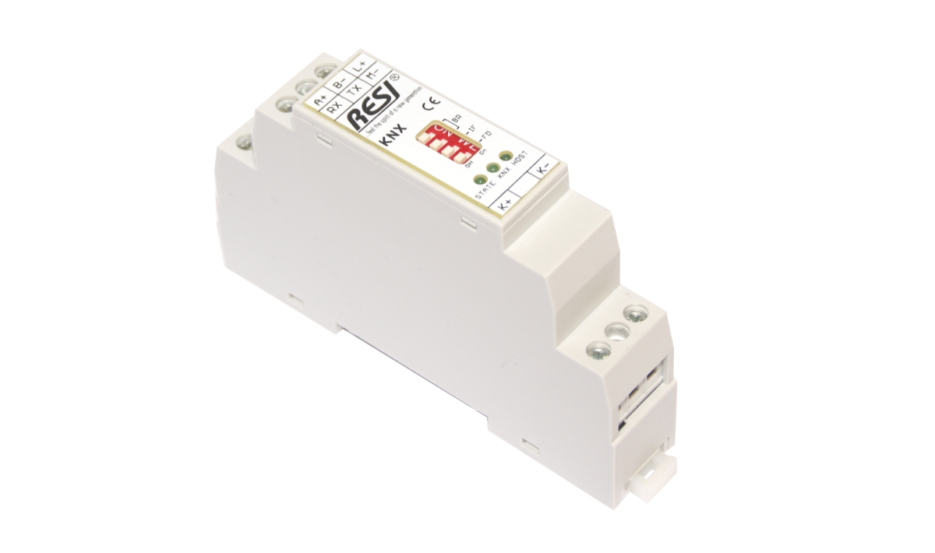
Knx to modbus

Slide 18
B. Light (Luz):
2RTD a Modbus; Extreme slim IO module with RS232/RS485 interface, MODBUS/RTU slave protocol and 2 sensor inputs for temperature sensors (PT100, PT200, PT500, PT1000, NI120) in 2 wire, 3 wire or 4 wire cabling.
MODBUS/RTU module to read two RTD temperature sensors via serial bus, configuration for each channel: RTD sensor type: PT100, PT200, PT500, PT1000, NI120, Measurement current: 100µA, 250µA, 500µA, Linearization: Europa, Amerika, Japan, ITS-90, Unit: Celsius, Fahrenheit, Kelvin, offset for zero point, integrated average calculation for each channel, Resolution: 24 bit ADC, Precision: +/-0,1°C, Speed: ca. 1Hz, Sensor connection: 2 wire, 3 wire or 4 wire connection, Host communication: via RS232 or RS485 with MODBUS/RTU slave protocol, Host baud rates: 9600, 19200, 38400 or 57600Bd, no, even or odd parity, 8 data bits, 1 stop bit, the sensor inputs are galvanically insulated to the serial interfaces, Configuration and testing of module with free PC software MODBUS configurator, Weight: 65g, Dimension (LxWxH): 17,5x90x58mm, Power supply: 12-48V=, Power consumption: <0.7W, Mountable onto a EN50022 DIN rail.

Slide 19
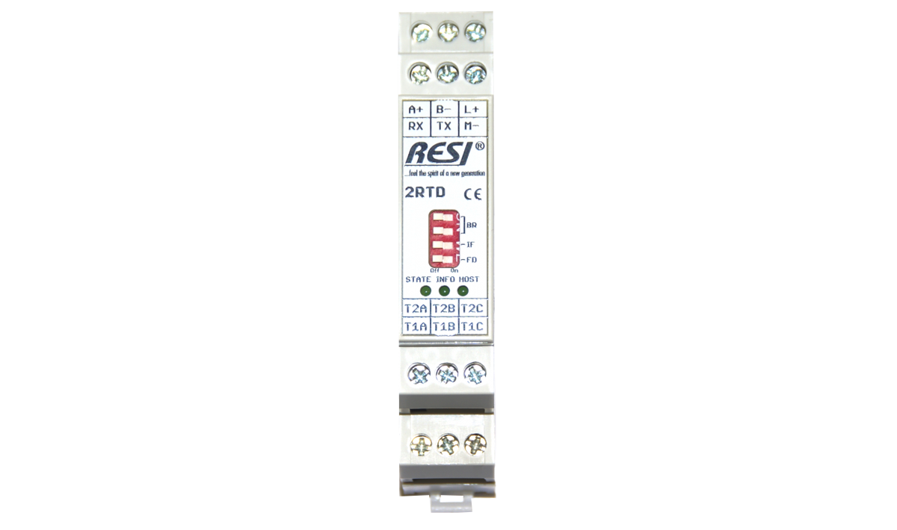
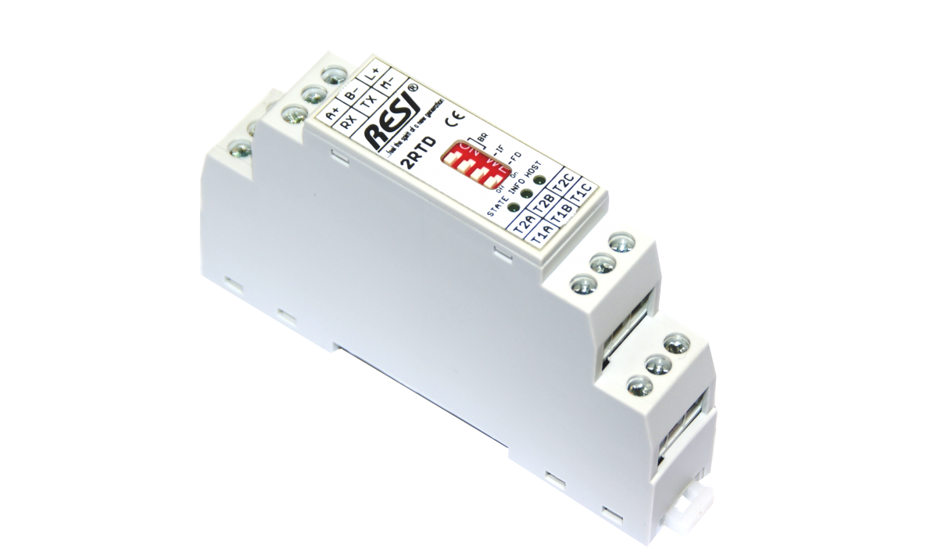
2rtD to Modbus

Slide 20
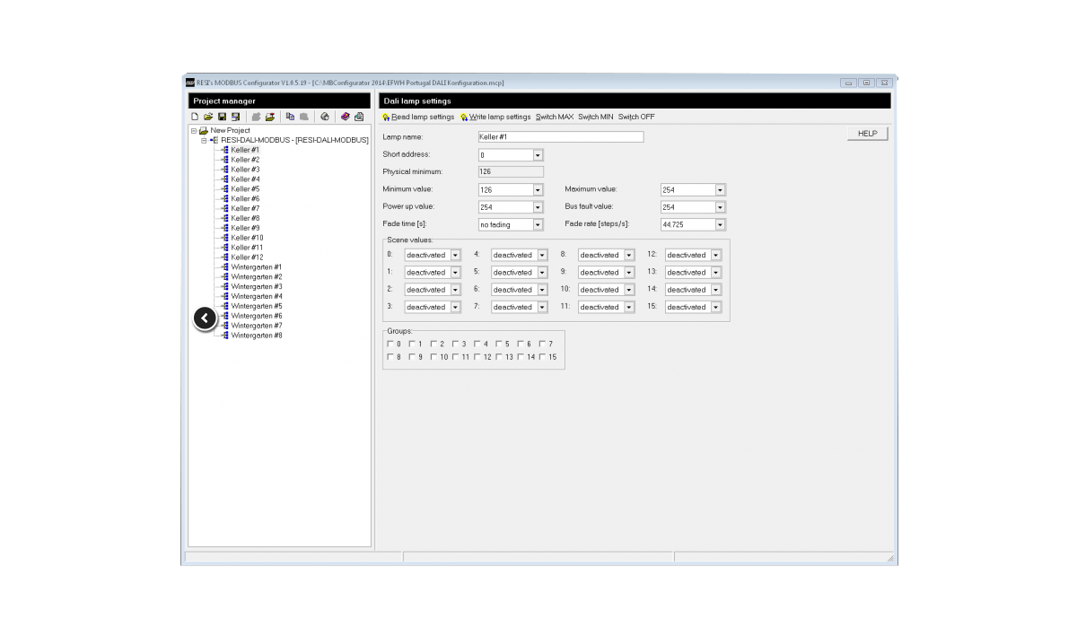
Resi Software configuration

Slide 21
